Slide 1
Stroke Prediction
Machine Learning Project
Jun Zhao
College of Engineering Northeastern University

Slide 2
Problem to Solve
In this project, we are going to build, fit, tune, test and visualize the model to predict the possibility of stroke with the following variables:
Hypertension
Gender
Heart disease
Marital status
Residence type
Working type
Smoking status

Slide 3
Data Source
We have retrieved the dataset of “Stroke Prediction Dataset” from Kaggle as the link enclosed: https://www.kaggle.com/fedesoriano/stroke-prediction-dataset
This dataset has 5110 rows with 12 columns
Among of the 12 columns, 10 are variables columns
We dropped the ID column because it doesn’t make any sense
The Stroke column is the actual result for each specific patient

Slide 4
Existing Solutions
There are a bunch of similar projects on the internet regarding to this topic, for example, we can find following topics from Kaggle:
https://www.kaggle.com/redhunter20/stroke-prediction-rf-acc-95
https://www.kaggle.com/umutalpaydn/stroke-eda-and-classification-94-60-accuracy
https://www.kaggle.com/ankithb21/stroke-prediction-ann-svm-94-acc
These three projects were completed by using Random Forest, Classification and SVM models respectively. In our project, we are going to focus on the implementation of Logistic Regression to combine RF and DNN.

Slide 5
Idea – What we want to implement?
As mentioned in the previous slide, comparing with most of the projects which focusing on a single model like RF, classification or DNN, we are going to implement with a hybrid of different models like RF and DNN.

Slide 6
Steps to implement
Import necessary packages and load data
Data preprocessing
Data visualization
Split train – test set, train model and data standardization
Build DNN
Hyper Tunning
Evaluate model and Ensemble
Test the outcome

Slide 7
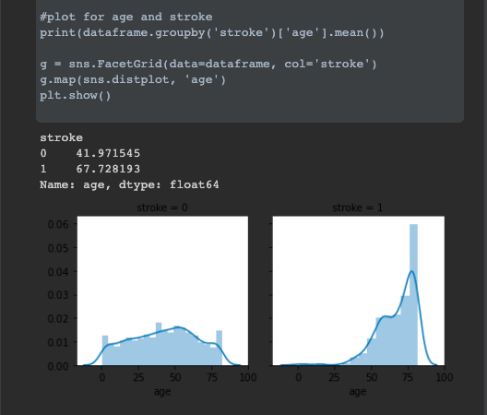
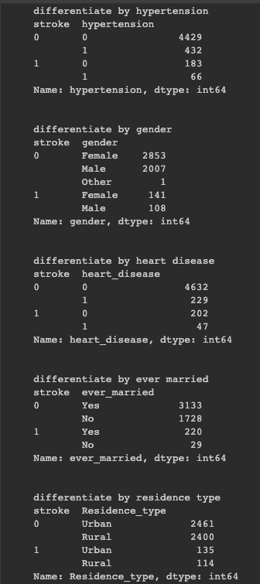
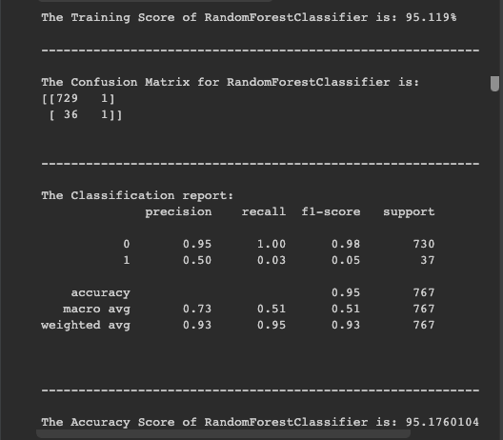
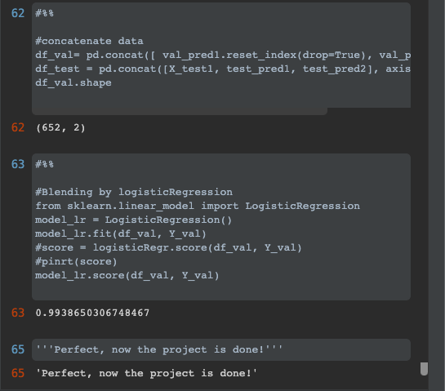
Some Performance Metrics

Slide 8
Future Scope
- The performance evaluated for predicting stroke is pretty high (over 99%). This is largely because of the integrity of the dataset, together with proper data preprocessing, model training and hyper tunning.
- For real life practices, we can’t always expect such a high accuracy as most of the datasets we can get are not perfect for the purpose of machine learning or data analysis.
- However, what we have done in this project can definitely extend to some other benefits like how to process data and choose DL models.

Slide 9
References
Dataset:
https://www.kaggle.com/fedesoriano/stroke-prediction-dataset/tasks?taskId=3281
Learning Resources:
College of Engineering, Northeastern University
Instructor: Dr. Ramkumar Hariharan
Teaching Assistant: Qilu Huang and Shankar

